Slide 1
Linear Regression
Two continuous variables
Brian Stock
03.27.17

Slide 2
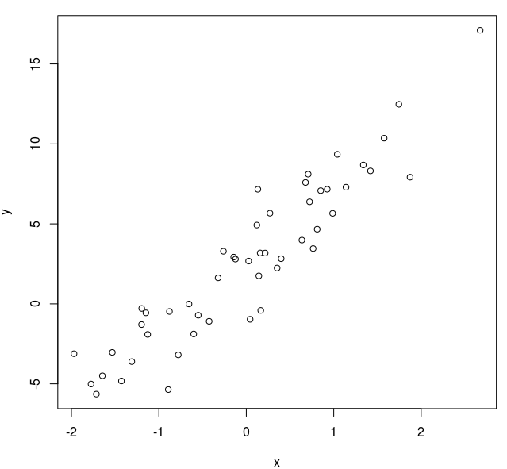
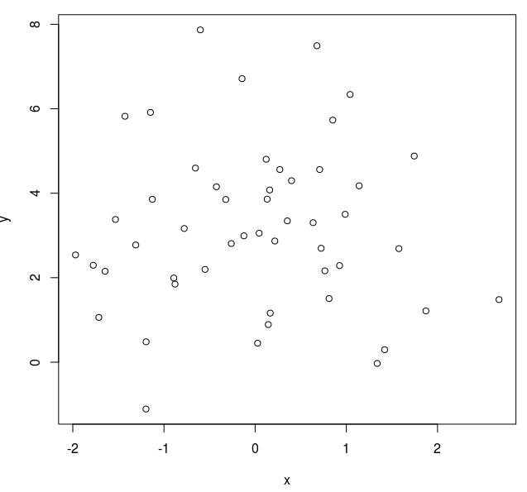
Linear Regression
Predicts Y from X (both continuous)
Y = α + β X

Slide 3
Regression assumes...
Random sample
The relationship between X and Y can be described by a line:
Y = α + β X

Slide 4
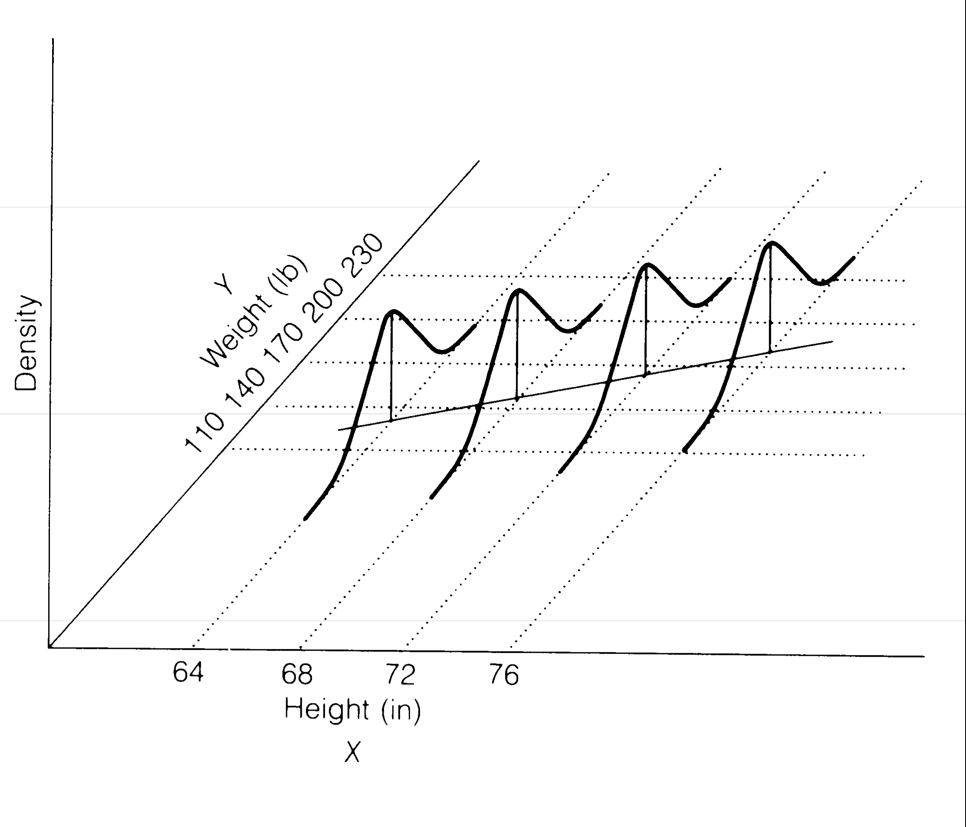
Regression assumes...
Random sample
The relationship between X and Y can be described by a line:
Y is normally distributed with equal variance for all values of X
Y = α + β X

Slide 5
2 Parameters
Y = α + β X

Slide 6
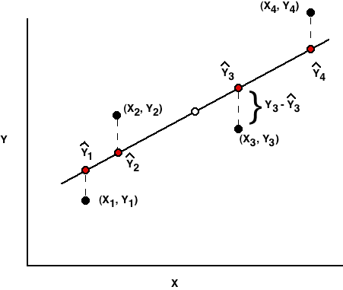
“Residual”
Notes:
Focus in the meaning of residuals

Slide 7
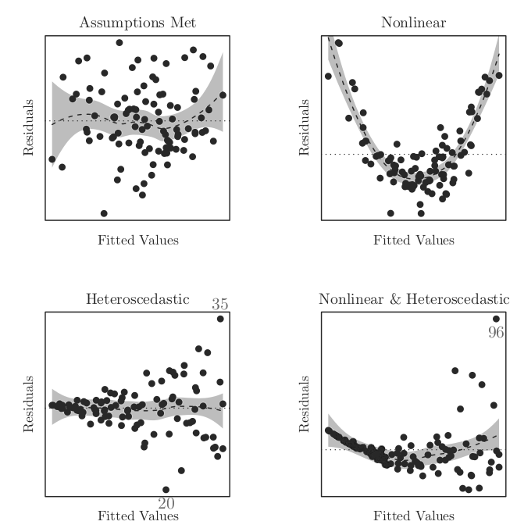


Residual Plots
Normal (no pattern)
Equal variance

Slide 8
Finding the "least squares" regression line
Minimize:
Your computer does this for you…
Notes:
This is the definition of a least squares regression line

Slide 9
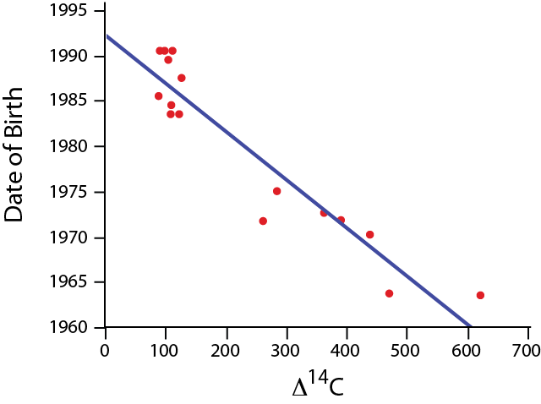
Ex: Age ~ TOOTH radioactivity
Many above ground nuclear bomb tests in the ‘50s and ‘60s may have left a radioactive signal in developing teeth.
Is it possible to predict a person’s age based on dental C¹⁴?
Data from 1965 to present from Spalding et al. 2005. Forensics: age written in teeth by nuclear tests. Nature 437: 333–334.
Notes:
Spalding,K. L.,B. A. Buchholz,L.-E. Bergman, H.Druid,and J.Frisén. 2005. Forensics:age written in teeth by nuclear tests. Nature 437: 333–334.

Slide 10
Ex: Age ~ TOOTH radioactivity
Data from 1965 to present from Spalding et al. 2005. Forensics: age written in teeth by nuclear tests. Nature 437: 333–334.
Notes:
Spalding,K. L.,B. A. Buchholz,L.-E. Bergman, H.Druid,and J.Frisén. 2005. Forensics:age written in teeth by nuclear tests. Nature 437: 333–334.

Slide 11
Predicting Y from X
If a cadaver has a tooth with Δ¹⁴C = 200, what does the linear model predict its year of birth to be?

Slide 12
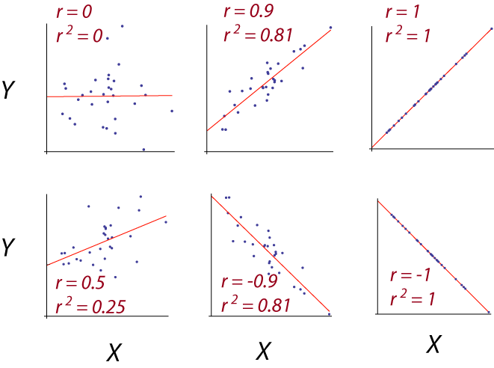
r²
predicts the amount of variance in Y explained by the linear model

Slide 13

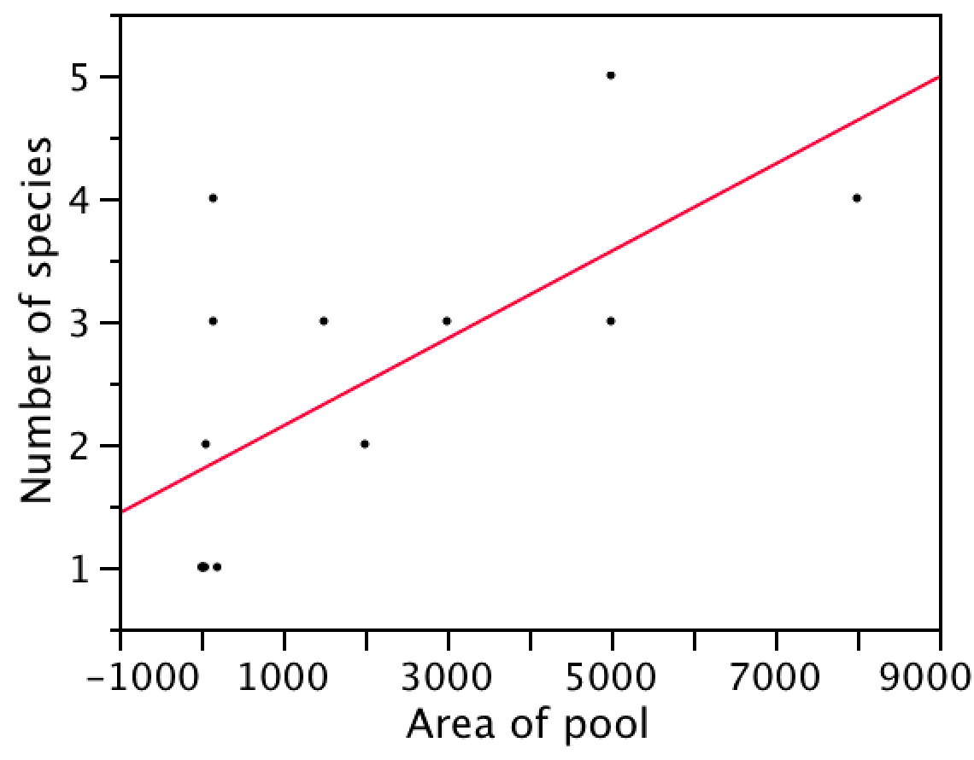
Caution: It is unwise to extrapolate beyond the range of the data.
Number of species of fish as predicted by the area of a desert pool
If we were to extrapolate to ask how many species might be in a pool of 50000m², we would guess about 20.

Slide 14
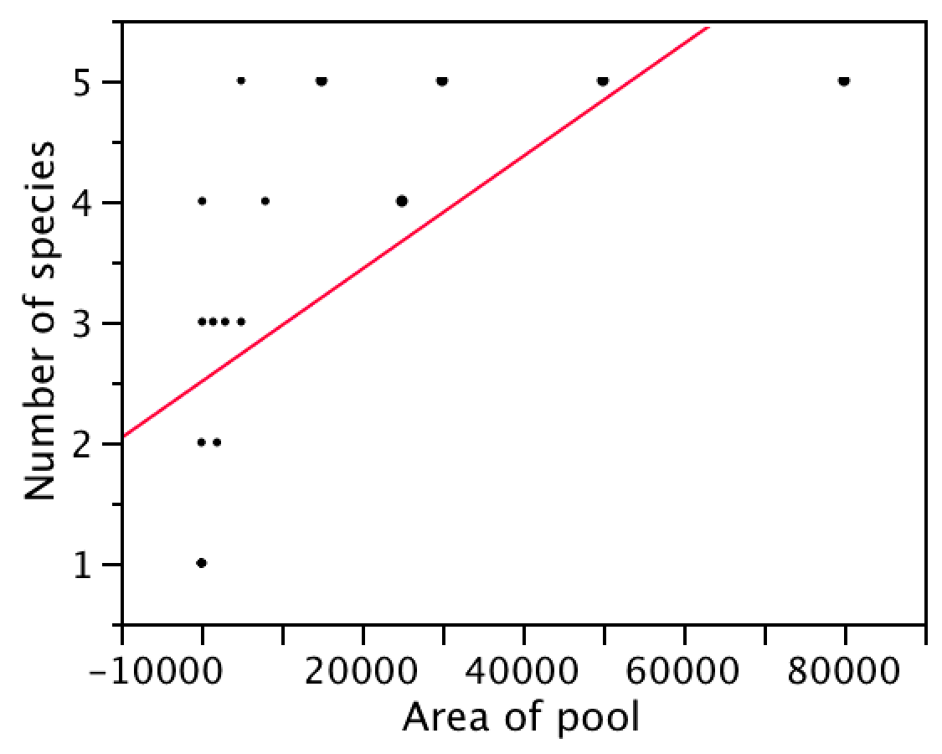
More data on fish in desert pools
Notes:
The data set actually goes up to about 85000 sq meters.

Slide 15
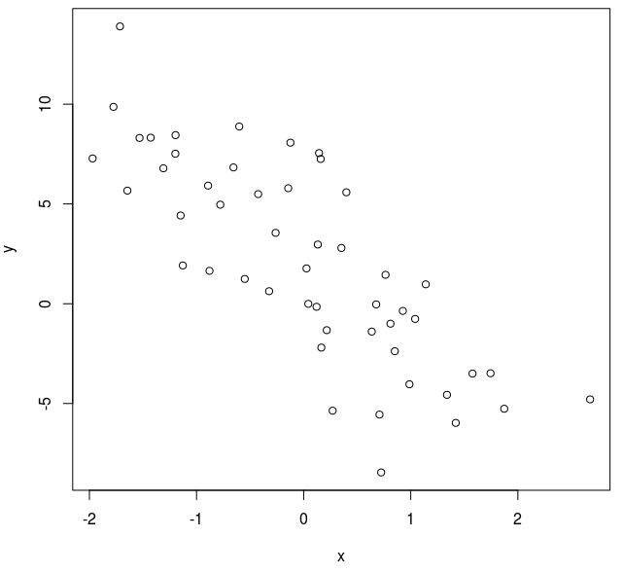
Regression hypotheseS
H₀: β = 0
H_{A}: β ≠ 0

Slide 16
Hypothesis test: β
H₀: β = 0
H_{A}: β ≠ 0
t_{0.0001(2),14}= ±5.36
So we can reject H₀, P<0.0001

Slide 17
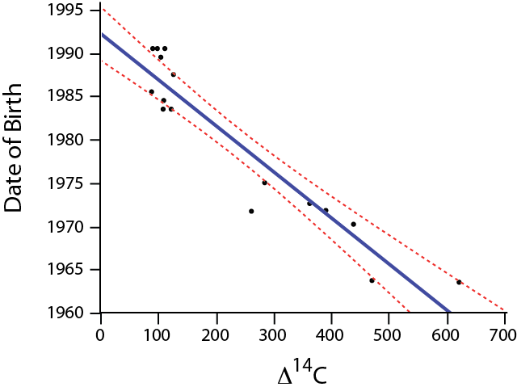
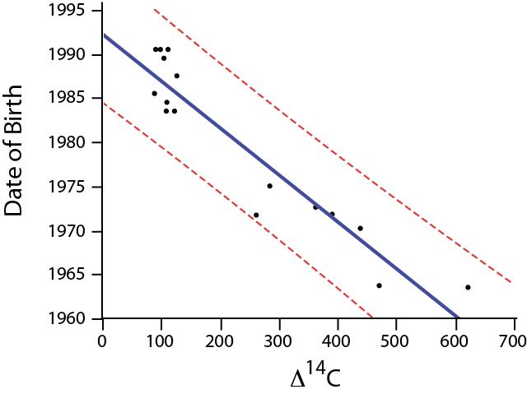
confidence intervals for predictions of:
mean Y
individual Y

Slide 18
Transformations

Slide 19
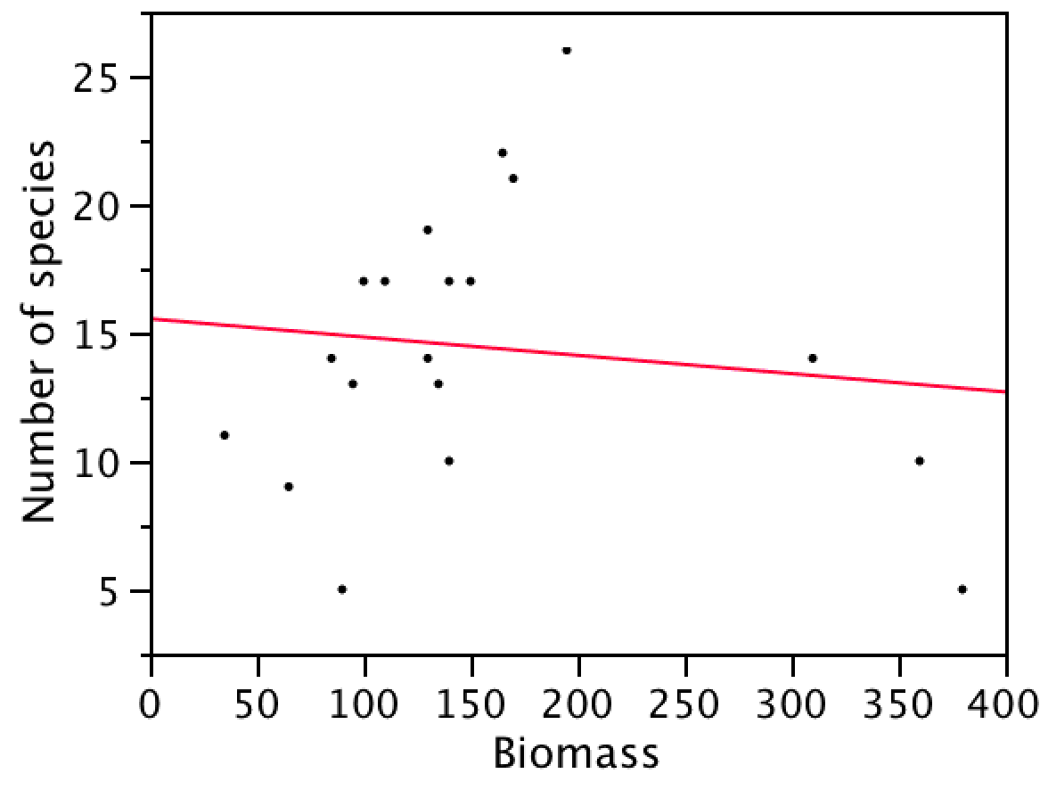
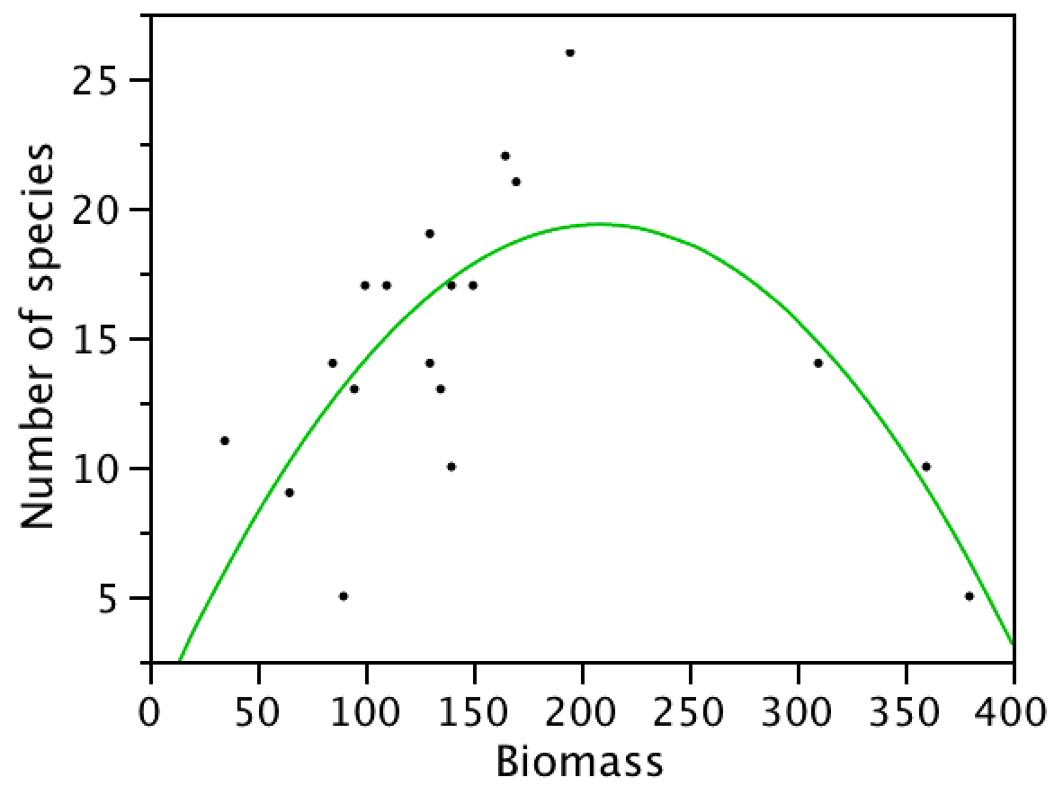
Polynomial regression
Number of species = 0.046 + 0.185 Biomass - 0.00044 Biomass²

